Slide 1
HP001 (056-11893-10) P2 MSOP
Made by : Zikun Zhao
Check by：Qinqin Li
Made time：2020-11-26
Check time：2020-11-27
Revision : 06

Slide 2
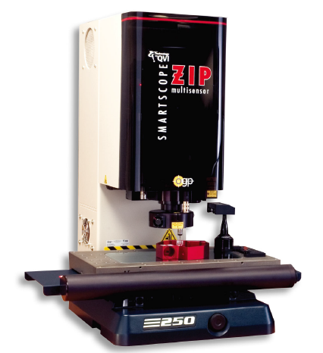
HP001 056-11893-10 MSOP |量测仪器-1#
Device name | OMM
Manufacturer | OGP
Device type | ZIP 250
Measuring Range | 250(X)×150(Y)×200(Z) mm
CCD Measuring Accuracy | X,Y: (1.8+6L/1000)μm Z: (2.5+5L/1000)μm (L: measure distance/mm)
Digital counter resolution | 0.001mm
Moving method | Automatic moving

Slide 3
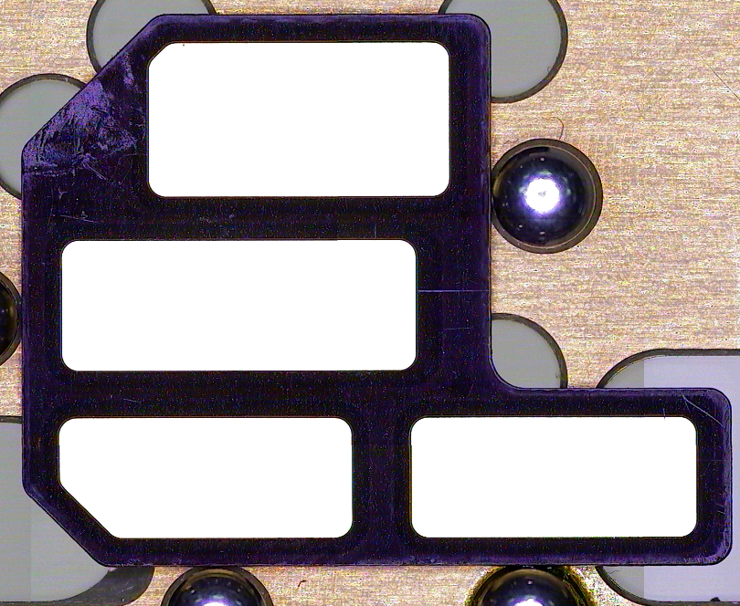
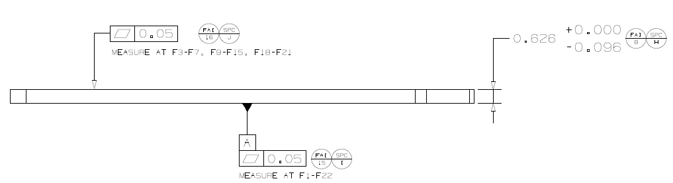
HP001 056-11893-10 | MSOP
FAI/ SPC | -FAI 15 / SPC I | Fixture | -量测治具Measuring fixture
Geometric Feature | -Flatness | Measurement Procedure | -Step 1 基准建立方法参照Datum2（Bottom side）. -Step 2 laser取22点测量面PL1计算平面度为FAI15,平面度公式为=MAX(P1:P22)+ABS(MIN(P1:P22)) -Step 1 Datum establishment method refers to Datum2 (Bottom side). -Step 2 Laser focusing Take 22 points to measure the plane PL1 and calculate the flatness as FAI15. The flatness formula is = MAX(P1:P22)+ABS(MIN(P1:P22)) .
Datums | -Datum 2-BOTTOM Side
Measurement Method | -Equipment :Laser -Multiplying power: 208X -Light source: 40%-60%
 | F1 | F2 | F3 | F4 | F5 | F6 | F7 | F8
X | 12.556 | 8.444 | 4.333 | 12.556 | 8.444 | 4.333 | 0.95 | 12.556
Y | 15.186 | 15.186 | 15.186 | 11.803 | 11.803 | 11.803 | 11.803 | 8.006
 | F9 | F10 | F11 | F12 | F13 | F14 | F15 | F16
X | 8.444 | 4.333 | 0.95 | 19.473 | 16.014 | 12.556 | 8.444 | 4.333
Y | 8.006 | 8.006 | 8.006 | 4.209 | 4.209 | 4.209 | 4.209 | 4.209
 | F17 | F18 | F19 | F20 | F21 | F22
X | 0.95 | 19.473 | 16.014 | 12.556 | 8.444 | 4.333
Y | 4.209 | 1.000 | 1.000 | 1.000 | 1.000 | 1.000
F3
F2
F1
F7
F6
F5
F4
F11
F10
F9
F8
F17
F16
F15
F14
F13
F12
X
F22
F21
F20
F19
F18
P0
Y

Slide 4
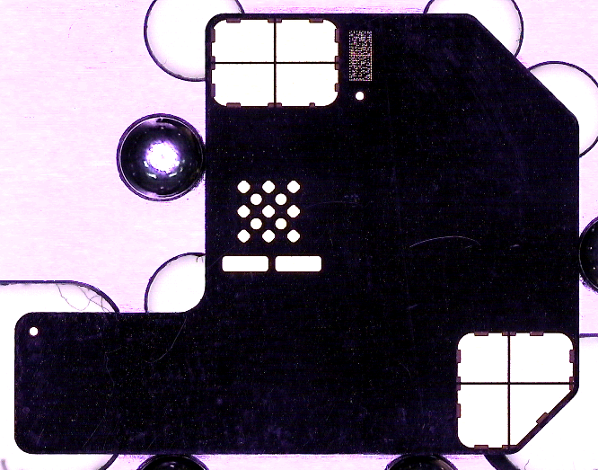
HP001 056-11893-10 | MSOP
FAI/ SPC | -FAI 16 / SPC J | Fixture | -量测治具Measuring fixture
Geometric Feature | -Flatness | Measurement Procedure | -Step 1 基准建立方法参照Datum1（TOP side）. -Step 2 取16点F3-F7, F9-F15, F18-F21 -Step 3 Laser聚焦取16点测量面PL1计算平面度为FAI16，计算平面度公式=MAX(F3:F7,F9:F21)+ABS(MIN F3:F7,F9:F21)) -Step 1 Datum establishment method refers to Datum1 (top side). -Step 2 take 16 points F3-F7, F9-F15, F18-F21 -Step 3 Laser focusing Take 22 points to measure the plane PL1 and calculate the flatness as FAI15. The flatness formula is = MAX(P1:P22)+ABS(MIN(P1:P22)) .
Datums | -Datum 2-TOP Side
Measurement Method | -Equipment :Laser -Multiplying power: 208X -Light source: 40%-60%
Datum A
 | F3 | F4 | F5 | F6 | F7
X | 4.333 | 12.556 | 8.444 | 4.333 | 0.95
Y | 15.186 | 11.803 | 11.803 | 11.803 | 11.803
 | F9 | F10 | F11 | F12 | F13
X | 8.444 | 4.333 | 0.95 | 19.473 | 16.014
Y | 8.006 | 8.006 | 8.006 | 4.209 | 4.209
 | F14 | F15 | F18 | F19 | F20 | F21
X | 12.556 | 8.444 | 19.473 | 16.014 | 12.556 | 8.444
Y | 4.209 | 4.209 | 1.000 | 1.000 | 1.000 | 1.000
F3
F4
F5
F6
F7
F9
F10
F11
F12
F13
F14
F15
X
F18
F19
F20
F21
P0
Y

